Slide 1
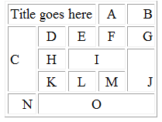
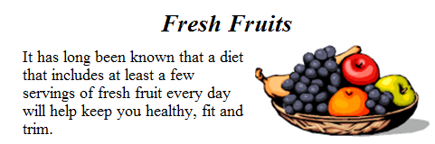
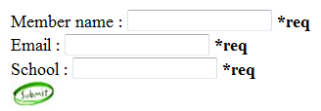
Homework
Create Web Pages like the following using tables:
Create a Web Page like the following using forms:

Slide 2
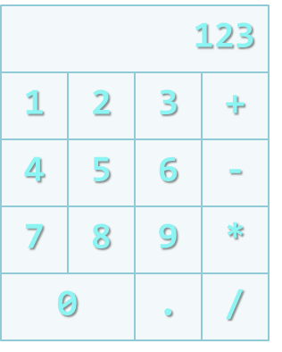
Homework (3)
Create a Calculator-like table. You should use a HTML 5 form for the Calculator
Buttons for all the numbers and operators (+, -, etc.)
Textbox for the result
Do not make the same styles as the example

